Slide 1

Statistical Computation Methods for Data Science Unit-V Lecture 2
By
S.U.RAVI KUMAR CHAVALI
Assistant professor of Mathematics
Department of Science and Humanities
Sreenidhi Institute of Science and Technology
Yamnampet, Ghatkesar.
1
Notes:
1

Slide 2
We discuss the following in today’s Lecture
Measurement of Secular trend

Slide 3
The following methods are generally used to determine trend in any given time series.
• Graphic method or eye inspection method
• Semi average method
• Method of moving average
• Method of least squares

Slide 4
Graphic method or eye inspection method:
Graphic method is the simplest of all methods and easy to understand. The method is as follows. First plot the given time series data on a graph. Then a smooth free hand curve is drawn through the plotted points in such a way that it represents general tendency of the series. As the curve is drawn through eye inspection, this is also called as eye-inspection method.

Slide 5
The graphic method removes the short term variations to show the basic tendency of the data.
The trend line drawn through the graphic method can be extended further to predict or estimate values for the future time periods.
As the method is subjective the prediction may not be reliable.

Slide 6
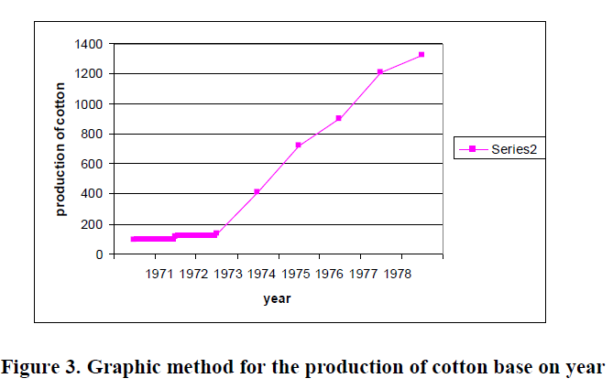
Eample:

Slide 7
Method of Semi Averages
In this method the whole data is divided in two equal parts with respect to time.
After the data have been divided into two parts, an average (arithmetic mean) of each part is obtained. We thus get two points.
Each point is plotted against the mid year of the each part. Then these two points are joined by a straight line which gives us the trend line.
The line can be extended downwards or upwards to get intermediate values or to predict future values.

Slide 8
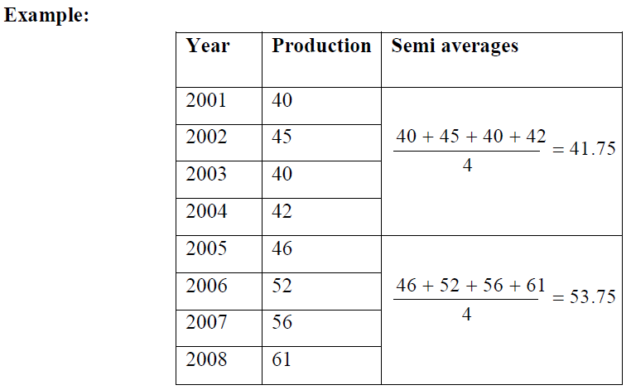

Slide 9
Method of Moving Average
It is a method for computing trend values in a time series which eliminates the short term and random fluctuations from the time series by means of moving average.
Moving average of a period m is a series of successive arithmetic means of m terms at a time.

Slide 10
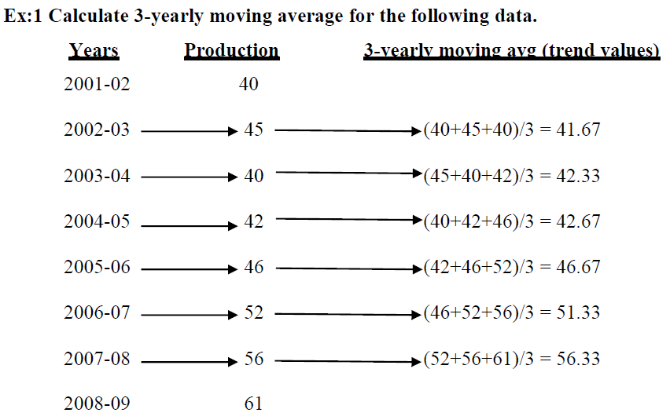

Slide 11
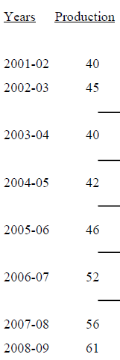

Slide 12
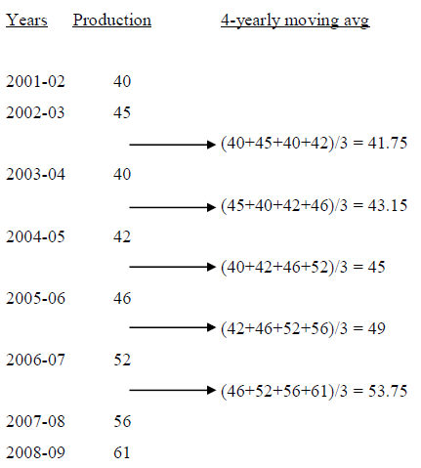

Slide 13
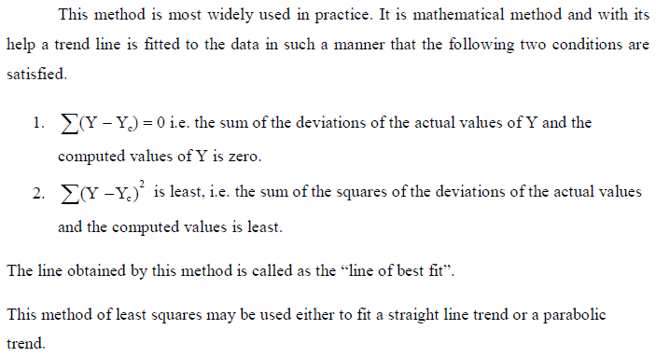
Method of Least Squares

Slide 14
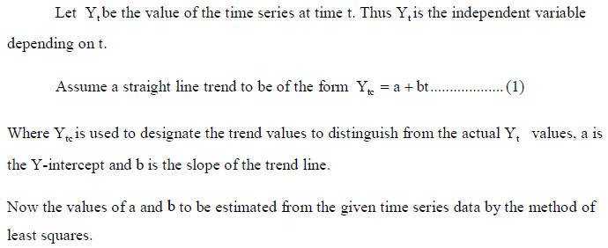
Fitting of a straight line trend by the method of least squares:

Slide 15


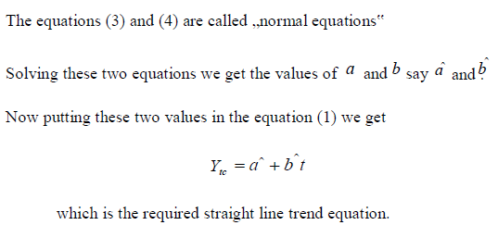

Slide 16
THANK YOU
Notes:
16

